Slide 1

Swaddling in Newborns
Student’s Full Name
Department & University
Course Number & Name
Instructor Name
Assignment Due Date

Slide 2
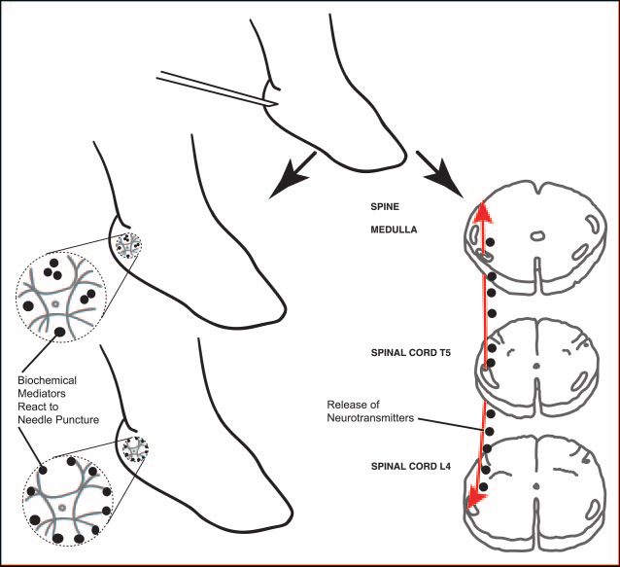
PICO Question
IN NEWBORNS, DOES SWADDLING AFFECT PAIN, VITAL SIGNS AND CRYING DURATION DURING HEEL LANCE?

Slide 3
Fact #1: Swaddling in babies
Swaddling babies has a number of benefits.
When babies are wrapped in swaddle blankets, they are less likely to wake up spontaneously.
The duration of their screaming is reduced (Asadi et al., 2018).
It assists with the newborn's adaptation to the extrauterine environment.
It avoids chills and assists with neuromuscular and motor development.
Swaddling also reduces the risk of sudden infant death syndrome
swaddling helps minimize infants' pain during heel lance
Notes:
Nonpharmacologic techniques can be used in conjunction with pharmacological pain management to provide a more holistic approach to pain relief. However, nonpharmacological techniques might not practically ease pain but they do divert the infants mind. Music therapy, nursing, and caressing, posture, confinement and swaddling are some of the most widely utilized nonpharmacologic treatments

Slide 4

Fact #2: swaddling in newborns
During a neonatal phase, infants attempt to adjust to their surroundings through biochemical and physiologic changes that affect all bodily systems.
One of the most common medical procedures performed on infants is the diagnostic heel lance
In France, a study was conducted on 430 newborns & it was found out that 19.8 percent of medical interventions for these newborns comprised of heel lance.
The swaddled babies’ PHR scores were noted to be higher as to those who were not swaddled before the procedure in this study by P<.05.
During the operation, swaddling had no effect on PHR ratings. As a consequence of these investigations, the heart rates of babies who were swaddled were lower (Möller & Rodenburg, 2019).
SpO2 was greater in swaddled neonates than in controls following the operation, with a significance difference.
Notes:
Parental agreement was obtained when the researcher addressed the parents. Prior to data collection, eight infants were subjected to a pretest. As part of pre-testing process, there was evaluation for applicability for experimental lay out and information form. The research did not include these eight infants. The next step was to begin the implementation phase. Informed consent was obtained from all legal guardians of babies who matched the study's inclusion criteria. It was necessary to acquire written agreement from parents and legal guardians of infants who satisfied the study's inclusion criteria after they were told of the study's purpose, nature, and implementation method as well as how and where the data would be utilized. Researcher uses a data collection form to collect information about new-borns and their parents who consented to participate in study. The researcher uses patient files and information supplied by parents to collect data.

Slide 5
Fact #3: Swaddling in newborns
The study included infants who were delivered and observed at Bagclar Training and Research Hospital. Seventy-four patients were sampled and would provide 90 percent power to detect a two-tailed significance level of.05 with a =.05 and b =.09 (Tauriana, Haryanto, & Pradanie, 2020).
Heel lancing was done on the control group with infants in a "normal posture." While lying on the operation table, babies naturally assumed a supine position, which was considered the normal position.
There were 54.1 percent of females in one group, and 48.6 percent of girls in the other group. At thirty-nine weeks, 70.3 percent of experimental babies and 56.8 percent of control babies had been born; at 24 hours after birth, 54.1 percent of experimental babies and 66.7 percent of control babies had been delivered and were still alive.
Notes:
When preterm babies were heel stuck, swaddling dramatically lowered their heart rate response to discomfort and pain ratings. In the treatment of infant pain, an interdisciplinary team approach is necessary, and nurses are an important part of that team. The goal of newborn pain management is to assist infants in pain management induced through treatment procedures, to decrease discomfort, & avoid unfavorable consequences which might come from pain. As a result, nurses should frequently and objectively measure infants' discomfort while providing provide pharmacologic and nonpharmacologic assistance to newborns who suffer pain.

Slide 6

Fact #4: Swaddling in newborns
The womb is a small space with defined limits that provides safety.
It can be imitated by the confinement provided by swaddling.
The swaddling cover surrounds the baby and creates an atmosphere that is similar to that of the womb.
Swaddling also helps babies retain positions which are consistent with their normal positions, lowering their physiologic and behavioral stress.
The levels of pain in swaddled babies during and after the operation were statistically substantially lower than those who were not swaddled in the current investigation.
Swaddling should allow the infant to move about freely while preventing excessive limb movement (Erkut & Yildiz, 2017).

Slide 7
Recommendations
It is essential that the nurses in charge of pain management have easy-to-use pain treatment techniques that do not take a lot of time.
In future research, parents should be given more time to decide whether they will allow their babies to participate. Here, they had only 20 minutes to make this decision.
To prevent physical movements from negatively impacting PHR and SpO2 levels, future study may advise that swaddling be done for a longer period of time before medical therapies are initiated.

Slide 8
References
Asadi, M. H., Changizi-Ashtiyani, S., Latifi, A. H., & Rajabnejad, M. R. (2018). A review of the role and importance of swaddling in Persian medicine. International Journal of Pediatrics, 6(11), 8495-8506.
Erkut, Z., & Yildiz, S. (2017). The effect of swaddling on pain, vital signs, and crying duration during heel lance in newborns. Pain Management Nursing, 18(5), 328-336.
Möller, E. L., de Vente, W., & Rodenburg, R. (2019). Infant crying and the calming response: Parental versus mechanical soothing using swaddling, sound, and movement. PloS one, 14(4), e0214548.
Tauriana, S., Haryanto, J., & Pradanie, R. (2020). Kangaroo Mother Care and Swaddling Methods In Low Born Weight Babies In Community Settings: A Systematic Review. STRADA Jurnal Ilmiah Kesehatan, 9(2), 1186-1195.

